Slide 1
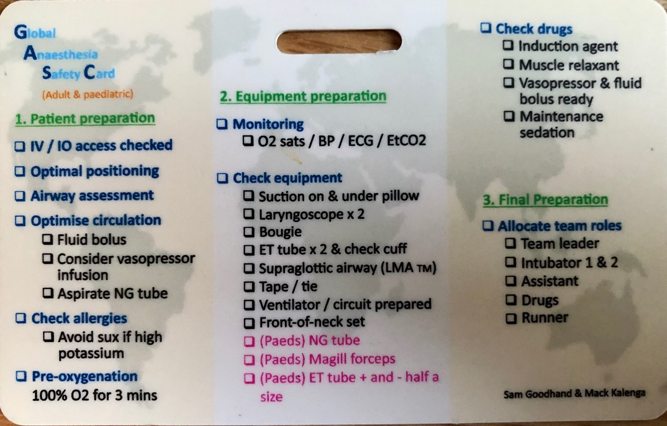
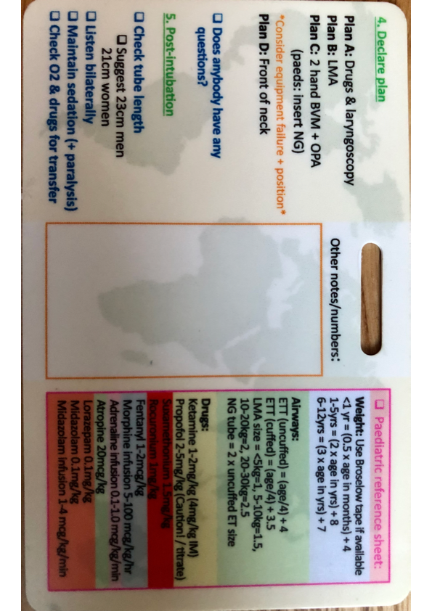
The Global Anaesthetic Safety (GAS) Card: Trialling a miniaturised intubation checklist in Zambia for global and Low & Middle-Income Country (LMIC) use
Goodhand, S, East Sussex NHS Healthcare Trust, Kalenga, M. University Teaching Hospital Lusaka, Cabaret, C. East Sussex NHS Healthcare Trust
Several difficulties in implementing and maintaining medical safety checklist use in LMIC have been identified ⁽¹⁾. Use of miniaturised intubation checklist card such as the DAS/RCOA/FICM/ICS checklist card is growing in the UK, partly due to their ability to overcome physical and cultural checklist availability⁽²⁾. In this joint pilot between UK and Zambian doctors, we trialled the use of a hybrid adult and paediatric intubation safety card for international and LMIC use.
METHODS
Pre-distribution survey sent to anaesthetists in University Teaching Hospital (UTH), Lusaka, Zambia.
Hybrid adult and paediatric safety card designed, printed and distributed
Anaesthetists then re-surveyed at 12 weeks post-distribution
RESULTS
Pre-survey = intubation checklists were very infrequently used (<25% of cases), but there was a significant interest in a personal safety aid.
14 respondents – twelve had used the GAS Card ‘in a real clinical situation’
All but one of the clinicians felt that the card increased their confidence in being prepared for emergency RSI, and would recommend it to others
Reasons for non-utilisation included perceptions of clinical urgency, and supervision by seniors who do not use checklists
DISCUSSION
Trial highlighted varying engagement between disciplines - non-physician anaesthetists (e.g., clinical officers) demonstrated substantially lower engagement with the survey processes.
This pilot demonstrated huge enthusiasm and approval for the GAS checklist card as a convenient patient safety tool.
The portable, on-the-person format may help reduce more institutional barriers to LMIC checklist use.
FUTURE DEVELOPMENT
GAS Cards now being distributed at SAFE Courses in LMIC (Dar Es Salaam and Nairobi so far in 2023) with WFSA and AAGBI support.
Seek endorsement (WFSA, Lifebox, RCOA)
Translations (French , Spanish, …
Continue to embed GAS Cards within existing training frameworks.
Gas card
Dr Kalenga using the Gas card in Lusaka
ACKNOWLEDGMENT
Dr Emma Lillie (Paediatric Anaesthetic Consultant, University Hospital Sussex & NAPGET: New Anaesthetic Postgraduate Education Trust
REFERENCES
¹ Cadman, V (2018) Use of the WHO Surgical Safety Checklist in low and middle income countries: a review of the literature. Journal of perioperative practice, 28 (12), 334-338.
² Higgs A et al.(2019) Introducing the Intubation Credit Card. ICU Management & Practice, 19 (4)

